Slide 1
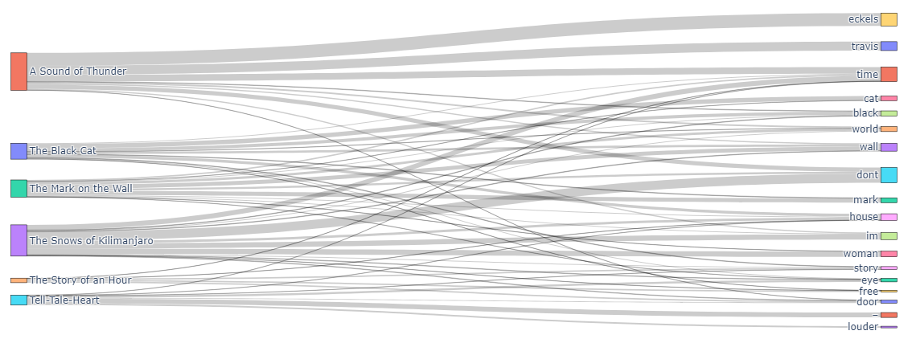




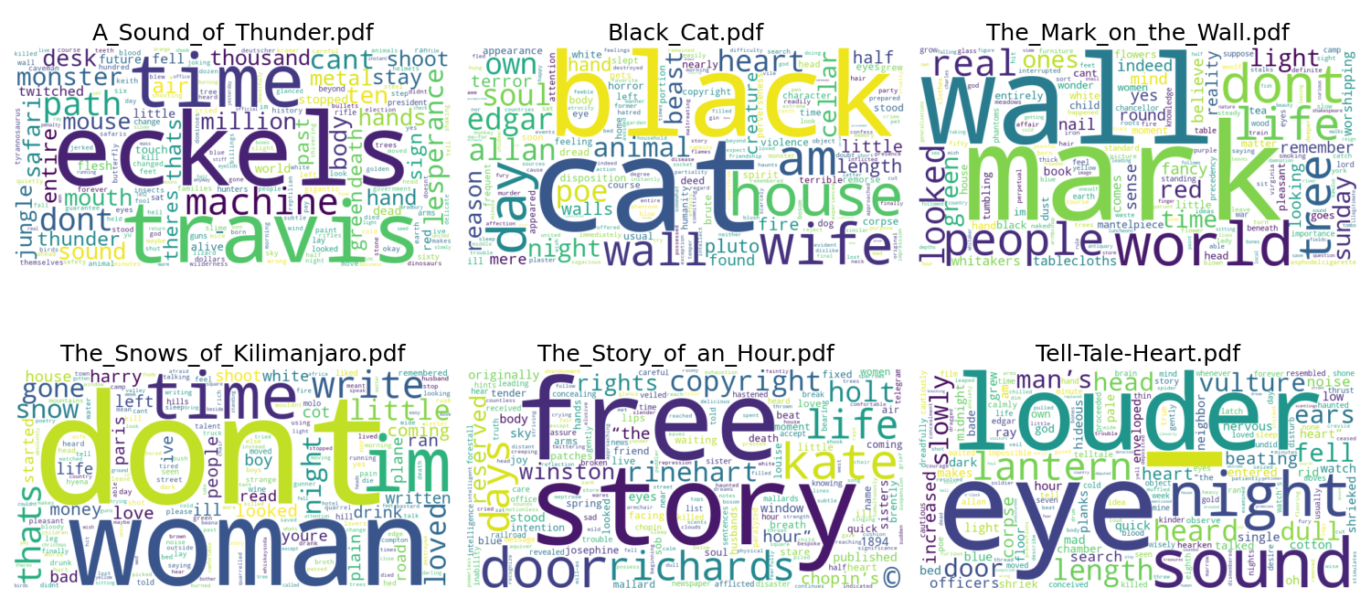
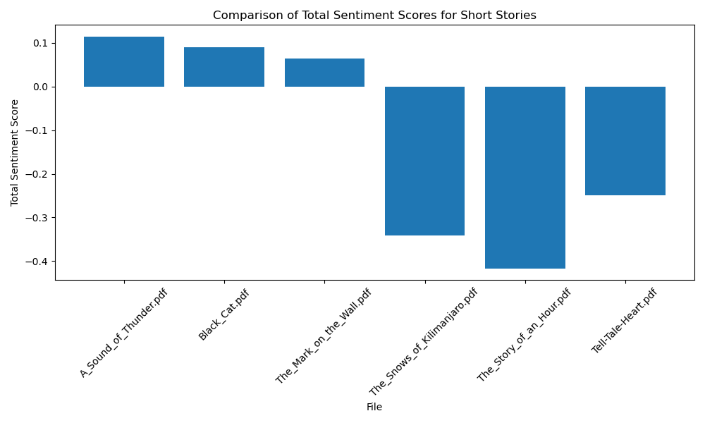
Mentor Name. : John Rachlin
Subject/Category : Natural Language Processing Framework
Class : DS 3500 Advanced Programming with Data Group # : 35
Textastic Tales: Comparative Short Story Analysis
Gabrielle Bambalan, Zoe Chapman, Desiree DeGennaro, Miguel Gonzales
Background, Motivation, and Goals
Short stories allow authors to create impactful narratives in short durations. As a result, the storyline is condensed and their word choice needs to be purposeful.
Our aim is to understand the diction, literary style, and underlying themes across famous short stories by popular authors.
By uncovering common themes and narrative structures that transcend individual authors, we hope to gain a greater understanding into the nuances of literary works enables a deeper observation into the human experience and each work's cultural context.
Process and Methods
Figure 2. Sankey Diagram
Visualizes flow from short story titles (sources) to the most common words between them (targets) with a flow size (value) that represents each word count.
Figure 3.
Sentiment Analysis
The NLTK library was used to calculate the sentiment scores, which measure how positive and negative the language is. Each score was averaged in their respective short story and compared with scores of other stories
Figure 1. Word Cloud
Shows the most frequent words in scale from largest to smallest in a blob. Subplots were created across each story. The most frequent words being:
Conclusion and Next Steps
The feasibility of using computational methods to analyze and compare literary works to identify common tones and themes provided valuable insights into the literary landscape of the range of short stories being compared.
The framework can be extended to detect genres or the evolution of language.
Expanding the dataset used, refining the preprocessing techniques, and exploring more advanced natural language processing techniques would increase efficiency and accuracy of the analysis, allowing for deeper insights into the interpretations of different pieces from different genres and time periods to explore implications for literary theory.
Author Contributions
Gabrielle: default parser, Sankey, documents Zoe: custom parser, Sankey Desiree: preprocessor, custom parser, Sankey, Miguel: Word cloud, Sentiment Score
All authors contributed to the creation of this slide

